Slide 1
Showtime: July 12 2022
MAINTAINING A
BURN FREE ZONE
Our Presentation Will Begin Soon!
Notes:
1
1

Slide 2
Showtime: July 12 2022
MAINTAINING A
BURN FREE ZONE
WELCOME!
Notes:
2
2

Slide 3
Today’s Specialist
Mark Yeck
Technical Specialist, CIH, CSP
ICW Group

Slide 4
Agenda:
Industry Common Hazards
Your Burn Free Zone Roadmap
The Challenge
Your Resources

Slide 5
Agenda:
Industry Common Hazards
- Welding
- Restaurants

Slide 6
Welding Burn Hazards
ICW Group Welding Claim Data
Less skilled or ‘non-professional’ welders.
Those in vicinity frequently injured.
Arc flash slag trapped in clothes, etc.
Need for better shielding.
Special shielding if awkward position.

Slide 7
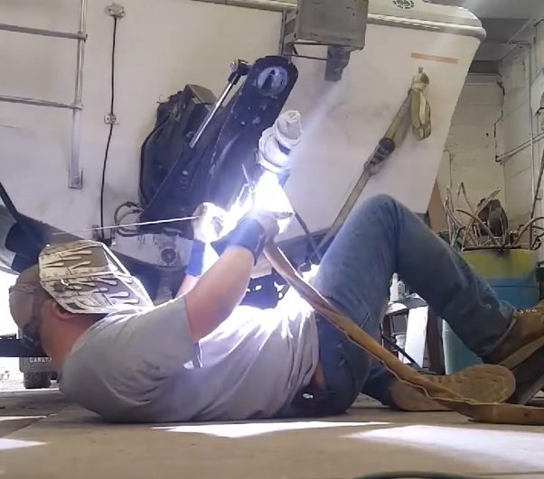
Welding Burn Hazards
What on earth could possibly go wrong?
Let’s take a quick poll!
Notes:
Poll Question –
What could go wrong with this man welding on his back?
Slag hits his shirt, and he gets burned
His shirt catches on fire
Boat catches on fire

Slide 8
Welding Burn Hazards
Let’s watch & find out!

Slide 9
Welding Burn Hazards
Common burn hazards:
Sparks and slag.
Workpiece & equipment - electrode holders, gun tips, nozzles, etc.
Arc rays - welders and workers in area.
Unprotected body - neck, face, arms, etc.
Clothing traps.

Slide 10
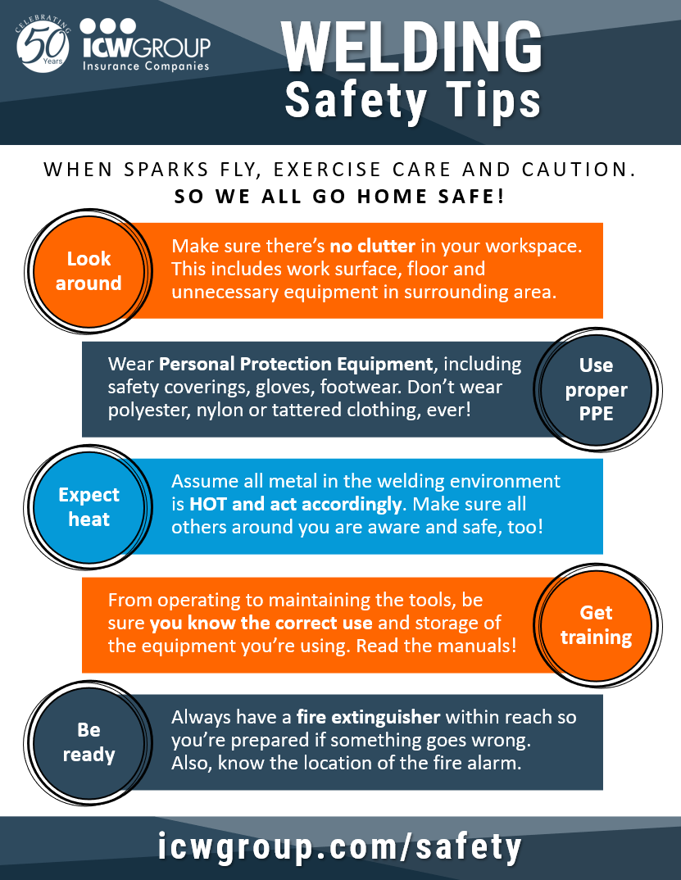
Welding Safety Tips
Exercise caution:
Look around, remove clutter.
Use PPE coverings, gloves, footwear.
Assume all metal is HOT.
Train for correct use.
Have extinguisher handy!
Notes:
Look around - Make sure there’s no clutter in your workspace. This includes work surface, floor and unnecessary equipment in surrounding area.
Use PPE - Wear Personal Protection Equipment, including safety coverings, gloves, footwear. Don’t wear polyester, nylon or tattered clothing, ever!
Expect heat - Assume all metal in the welding environment is HOT and act accordingly. Make sure all others around you are aware and safe, too!
Get training - From operating to maintaining the tools, be sure you know the correct use and storage of the equipment you’re using. Read the manuals!
Be Ready – Always have a fire extinguisher within reach so you’re prepared if something goes wrong. Also, know the location of the fire alarm.

Slide 11
Agenda:
Industry Common Hazards
- Welding
- Restaurants

Slide 12
Restaurant Burn Hazards
ICW Group Restaurant Claim Data
Hot liquids: Coffee, tea, water, steam.
Check recent accident investigations:
Who’s getting burned?
Lessons learned and changes made?
What else besides ‘re-training’?
Notes:
ICW Group Claim Data suggests Coffee, Tea, Water, and Steam are highest frequency
Think about;
Who is getting burned at your Restaurant?
What lessons were learned, or changes made from the last 5 AI’s?
What else besides ‘re-training’?

Slide 13
Restaurant Burn Hazards
In fact, according to the Burn Foundation, the restaurant and food service industry reports around 12,000 burns every year, the highest number of burns of any employment sector. http://www.burnfoundation.org/
12,000
OSHA: deep fryers #1 cause of burns in restaurant kitchens.
Essential to train employees on use and safety precautions.
Restaurant fires? 20% of are caused by deep fryers!
burns reported yearly by restaurant and food service.
https://apicancleanit.com/2018/10/20/20-percent-of-restaurant-fires-caused-by-deep-fryers/
Source: Burn Foundation
https://apicancleanit.com/2018/10/20/20-percent-of-restaurant-fires-caused-by-deep-fryers/
https://amtrustfinancial.com/blog/loss-control/how-to-prevent-burns-commercial-kitchens
Notes:
In fact, according to the Burn Foundation, the restaurant and food service industry reports around 12,000 burns every year, the highest number of burns of any employment sector. http://www.burnfoundation.org/

Slide 14
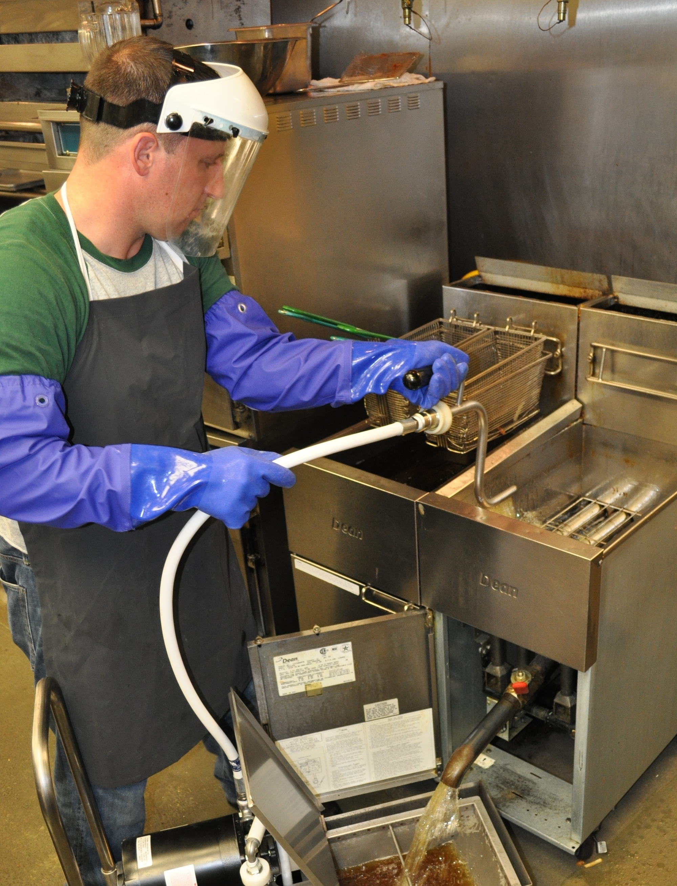
Restaurant Burn Hazards
Lowering damp/frozen food into fryer.
Changing exhaust filters.
Filtering or replacing grease (open top containers, manual hand valves etc.).
Moving fryer for cleaning.
See “Young worker guidance” at OSHA: https://www.osha.gov/etools/young-workers-restaurant-safety

Slide 15
Restaurant Burn Hazards
What on earth could possibly go wrong?
Let’s take a quick poll!
Notes:
Poll Question –
What could go wrong with this fryer on fire?
Employees put out fire quickly with fire extinguisher.
Employees run off to get help.
Employee throws a bucket of water on the grease fire.

Slide 16
Restaurant Burn Hazards
Let’s watch & find out!

Slide 17
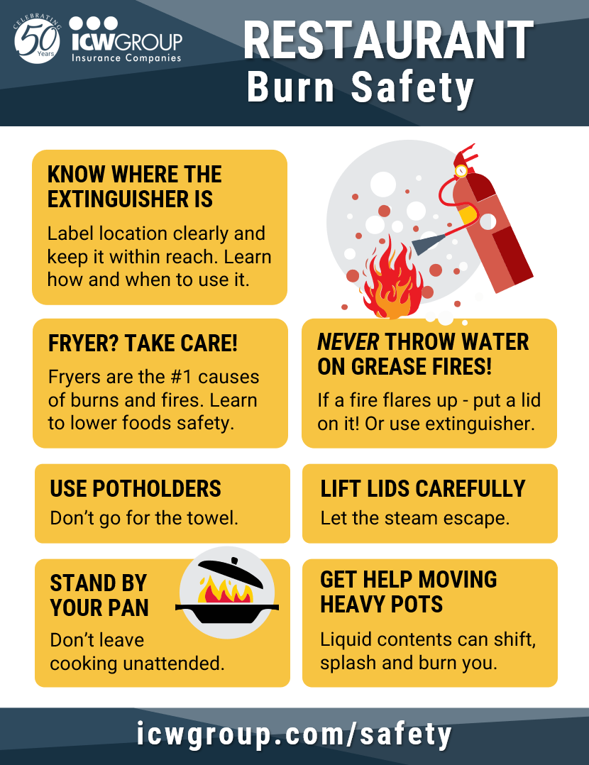
Restaurant Burn Hazards
To reduce risk of burns from fryers, hot fluids, and cooking pots?
Look, slow down, reduce traffic.
Don’t over fill, limit handling.
Use Job Hazard Analysis and Standard Operating Procedures.
Limit high risk work to qualified, trained employees.

Slide 18
Agenda:
Industry Common Hazards
Your Burn Free Zone Roadmap
The Challenge
Your Resources

Slide 19
Your Burn Free Zone Roadmap
Burn Prevention Guide
Conduct Job Hazard Analysis for burn risk to identify burn hazards.
Document Standard Operating Procedures and mitigations.
1
IDENTIFY HAZARDS
2
DOCUMENT SOP

Slide 20
Your Burn Free Zone Roadmap
Provide training:
How to use equipment
Mitigation SOP, PPE Certification, work qualifications
Audit process to maintain implementation with staff.
1
IDENTIFY HAZARDS
3
PROVIDE TRAINING
2
DOCUMENT SOP
4
AUDIT PROCESS

Slide 21
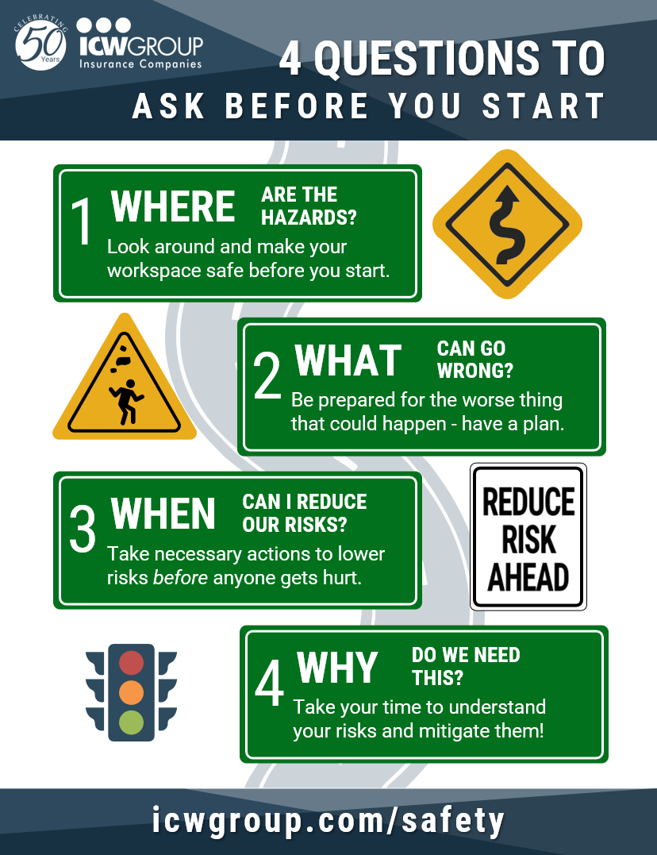
Your Burn Free Zone Roadmap
See poster on Where, What, When, Why
Where are the hazards? Make your workspace safe before you start.
What can go wrong? Be prepared for the worse and have a plan.
When can I reduce our risks? Lower risks before anyone gets hurt.
Why do we need this? Understand your risks and mitigate them!

Slide 22
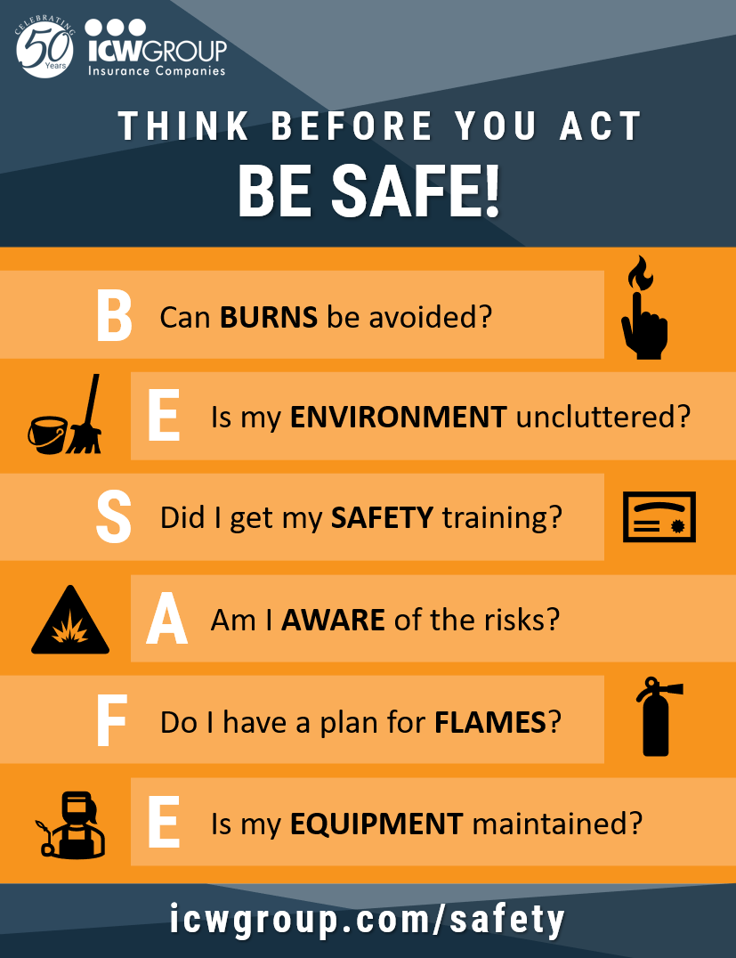
Your Burn Free Zone Roadmap
Bonus Poster: Can YOU “B.E. S.A.F.E.”?
Can BURNS be avoided?
Is my ENVIRONMENT uncluttered?
Did I get my SAFETY training?
Am I AWARE of the risks?
Do I have a plan for FLAMES?
Is my EQUIPMENT maintained?
Notes:
Can BURNS be avoided?
Is my ENVIRONMENT uncluttered?
Did I get my SAFETY training?
Am I AWARE of the risks?
Do I have a plan for FLAMES?
Is my EQUIPMENT maintained?

Slide 23
Agenda:
Industry Common Hazards
Your Burn Free Zone Roadmap
The Challenge
Your Resources

Slide 24
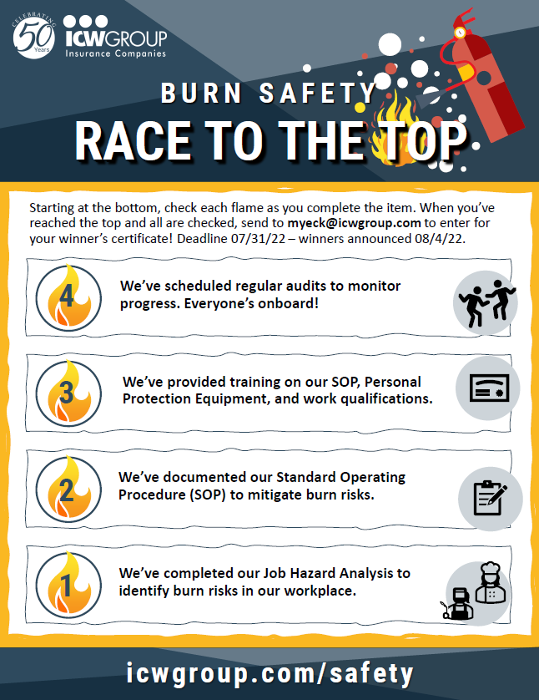
The Safety Challenge
Let’s Race to the Top!
Complete 4 critical safety tasks:
Job Hazard Analysis
Standard Operating Procedure
Training
Schedule Audits

Slide 25
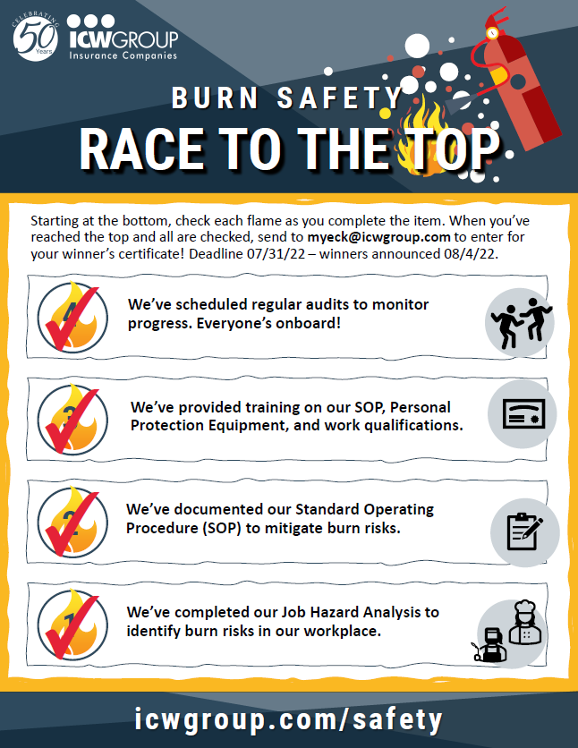
The Safety Challenge
Let’s Race to the Top!
Complete all 4 items.
Click on email link and attach card to get your Safety Certificate!
Deadline 7/31!
Winners announced 8/4
Join us!

Slide 26
Agenda:
Industry Common Hazards
Your Burn Free Zone Roadmap
The Challenge
Your Resources

Slide 27
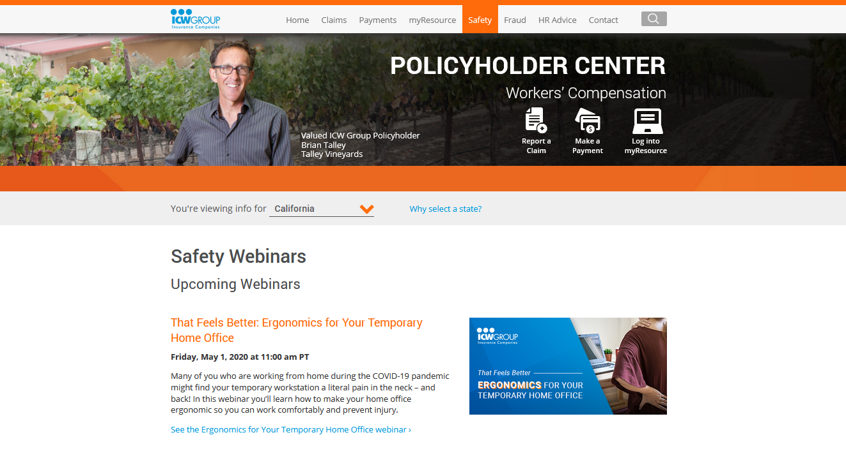
Find all resources!
ICW Group Policyholder Website
Safety and Risk Management area!
Click Safety Webinars
Maintaining a Burn Free Zone
icwgroup.com/safety
Notes:
27
27

Slide 28
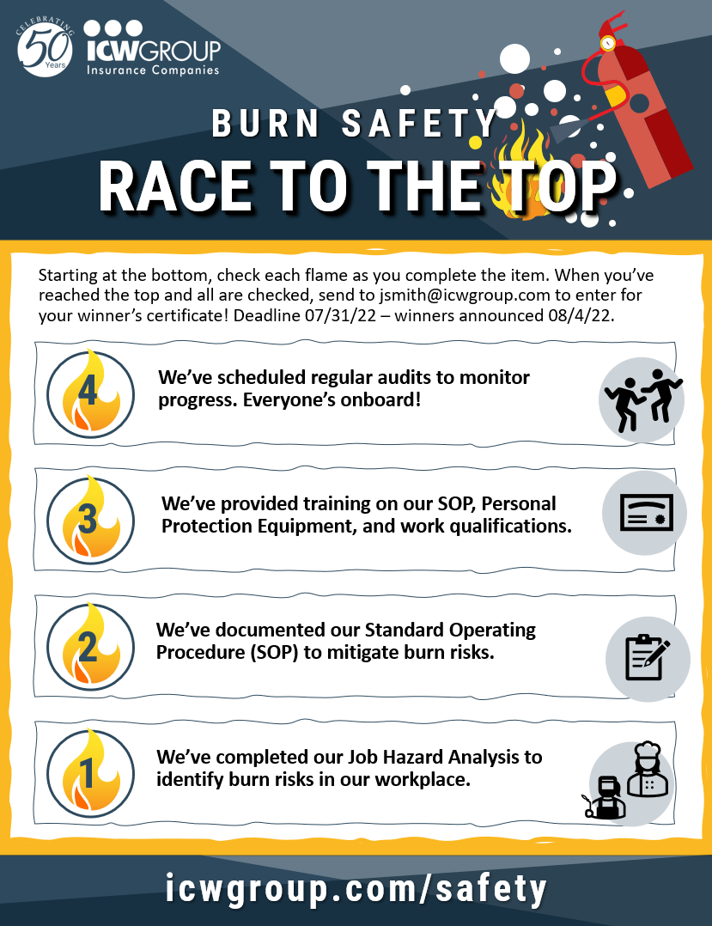
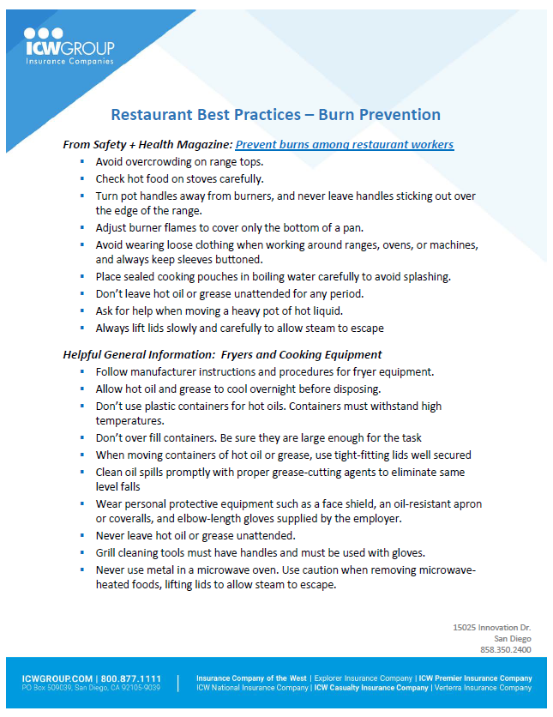
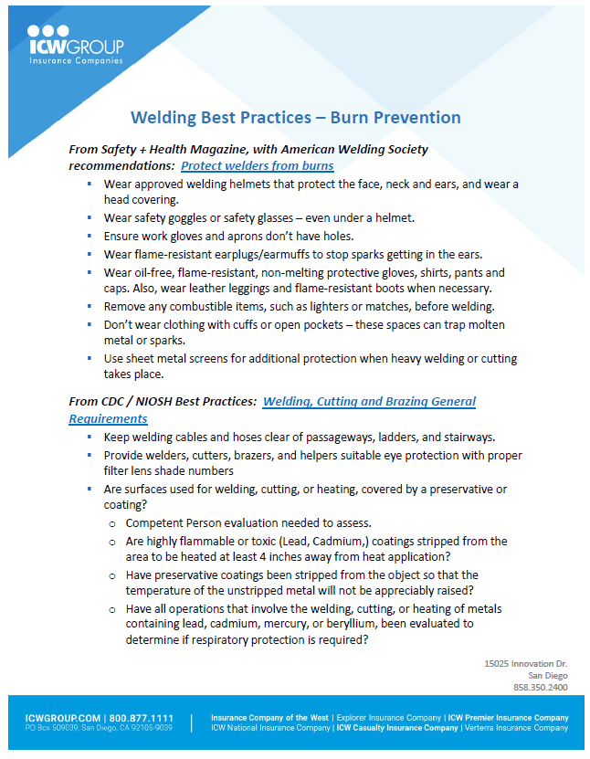
Find all resources!
Be sure to download all your references!
We’ll also make all links mentioned available.
icwgroup.com/safety
Notes:
28
28

Slide 29
Showtime: July 12 2022
MAINTAINING A
BURN FREE ZONE
THANK YOU !!!
Notes:
29
29

