Slide 1
WATCH YOUR STEP!
Preventing Slips, Trips & Falls in Your Workplace
Our Presentation Will Begin Soon

Slide 2
WATCH YOUR STEP!
Preventing Slips, Trips & Falls in Your Workplace
ICW Risk Management Services

Slide 3
Today’s Presenter:
Brian Piñon

Slide 4
Workplace Impact

Slide 5
2nd Most Costly
ICW Group Customers - 5 Year Loss by Risk Exposure
$278M
5-year cost of slips, trips & falls
*Source: Bureau of Labor Statistics

Slide 6
2nd Most Costly Risk Exposure
ICW Group Policyholders
$20K
14
Average cost per claim
Average days away from work per claim

Slide 7
Today’s Topics
The Risk-Based Approach
Solving for Slips
Housekeeping
Surface Irregularities
Behavioral Factors
Valuable Resources

Slide 8
Today’s Topics
The Risk-Based Approach
Solving for Slips
Housekeeping
Surface Irregularities
Behavioral Factors
Valuable Resources

Slide 9
The ICW Group Risk Framework
Traditional Approaches Give Way to New Methods
FREQUENCY
NUMBER OF TIMES EXPOSED TO HAZARD
RISK
LIKELIHOOD
CHANCE SEVERITY WILL OCCUR
SEVERITY
CONSEQUENCES OF OCCURRENCE

Slide 10
The ICW Group Risk Framework
FREQUENCY
NUMBER OF TIMES EXPOSED TO HAZARD
LIKELIHOOD CHANCE SEVERITY WILL OCCUR
SEVERITY
CONSEQUENCES OF OCCURRENCE
Length of time walking during shift
Floor Friction
Housekeeping
Surface Irregularities
Human Factors
Prior injuries
Health of the worker
Availability of modified duty

Slide 11
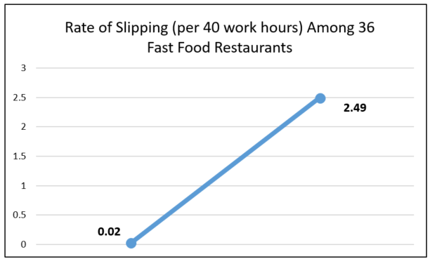
Case Study – Fast Food Restaurants
Top Performer: Workers slip
1x
per year
Bottom Performer: Workers slip
X = .44
2.5x
per week!

Slide 12
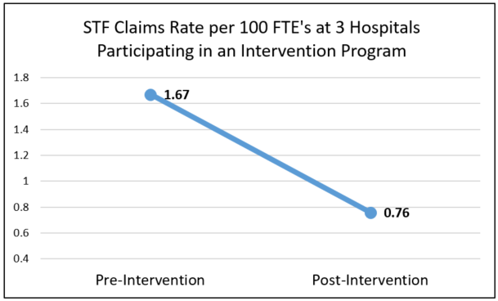
Case Study – Hospitals
54%
improvement with proactive slip, trip, fall intervention!

Slide 13
Today’s Topics
The Risk-Based Approach
Solving for Slips
Housekeeping
Surface Irregularities
Behavioral Factors
Valuable Resources

Slide 14
Floors Vs. Shoes
Walking surface & shoe sole material interact
Provides specific amount of friction
Each step taken requires certain amount of friction to prevent slipping across the floor!
Available Friction
<
Required Friction
=
Slip!

Slide 15
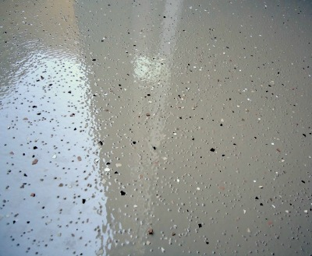
Improving Friction
Textured & Adhesive Coatings
Chemical Etching
Abrasive Tapes

Slide 16
Floor Cleaning Tips
Choose the right cleaner
Follow manufacturer guidelines
Use optimal technique
Establish frequency

Slide 17
Cleaning Agent Qualities
Alkaline Cleaners
Neutral Cleaners
Microbial / Enzymatic Cleaners

Slide 18
Cleaning Agent Qualities
Alkaline Cleaners (Degreasers):
React with fats and oils to convert to soap
Must be rinsed away
Tend to get over-diluted

Slide 19
Cleaning Agent Qualities
Neutral Cleaners:
Typically ideal for light soil loads
Often used on glossy floors and those that may be damaged by acid and base cleaners
Tend to get over-dosed

Slide 20
Cleaning Agent Qualities
Microbial / Enzymatic Cleaners
Use enzymes to break down proteins, fats, carbohydrates
Require sufficient “break down” time
Must not use with hot/ warm water

Slide 21
Effective Mopping Tips
Single Step vs Two step mopping
Figure 8 technique
Solution replacement guidelines
Mop head cleaning & replacement routine
Separate mop heads for areas with different contaminants

Slide 22
Effective Mopping Tips
Study results measuring coefficient of friction on floor surfaces using different cleaning methods
Applied Technique | Coefficient Of Friction (COF)
1. Over-dilute & single-step mop with degreaser(alkaline) | .37
2. Over-concentrate & single-step mop with neutral cleaner | .39
3. Two-step mop with neutral at recommended concentration | .58
4. Two-step mop with degreaser at recommended concentration | .77

Slide 23
Effective Mopping Tips
Each .1 decrease in the COF = 21% more slipping!
Applied Technique | Coefficient Of Friction (COF)
1. Over-dilute & single-step mop with degreaser(alkaline) | .37
2. Over-concentrate & single-step mop with neutral cleaner | .39
3. Two-step mop with neutral at recommended concentration | .58
4. Two-step mop with degreaser at recommended concentration | .77

Slide 24
Matting
Can reduce contaminants tracked in
May provide more friction near liquid sources
Quality Matters
Must be routinely inspected, cleaned, replaced

Slide 25
Entryway Matting
Both inside & outdoor recommended
Scraper Mats: “Scrape” away dense contaminants–such as dirt, mud, grime, snow
Wiper Mats: “Wipe” off moisture, less dense particles
Wiper-Scraper Mats: Wipe and scrape

Slide 26
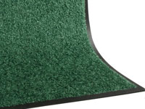
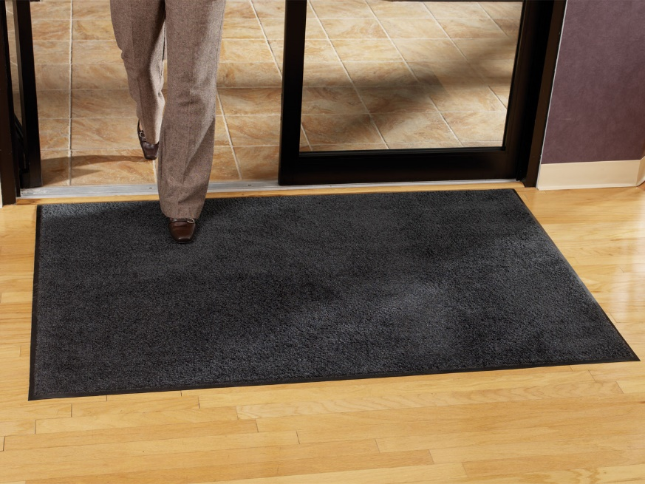
Matting
Wiper Mats

Slide 27
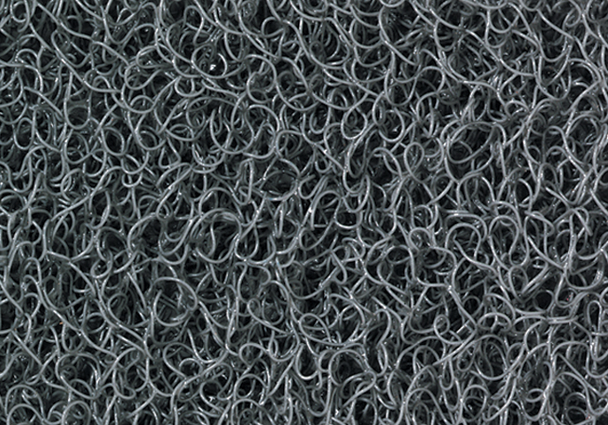
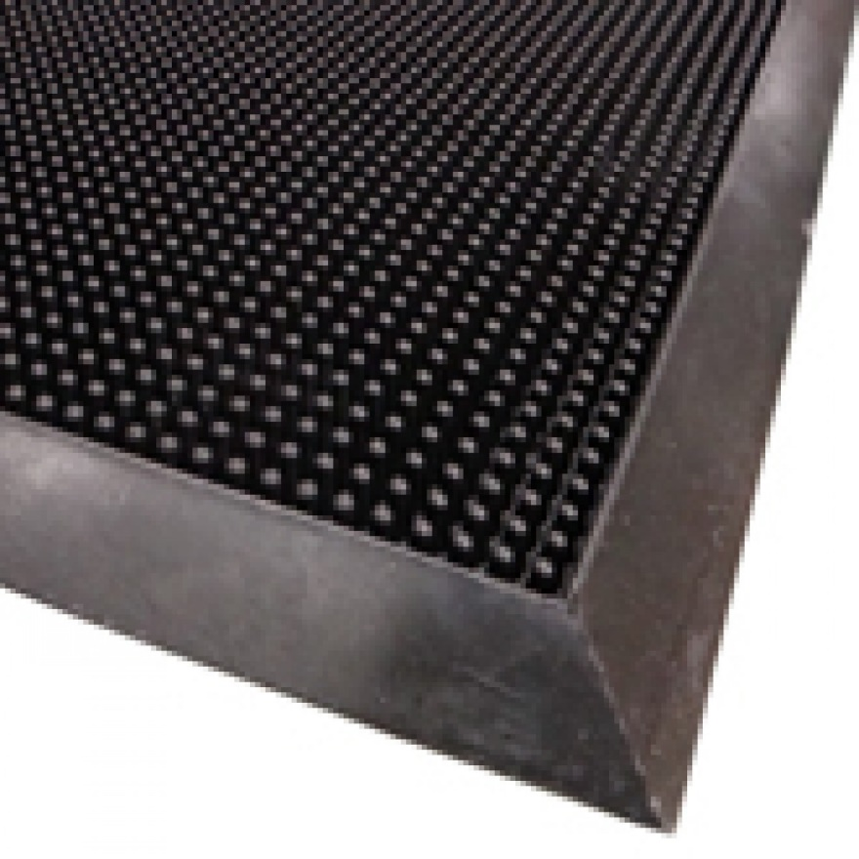
Matting
Scraper Mats

Slide 28
Matting
Entrance Mats – Length considerations
Mat Length Chart
CONDITION | # OF STEPS | LENGTH
Dry | 6-8 Steps | 14 – 19 feet
Rain | 8-10 Steps | 19 – 24 feet
Snow | 10-12 Steps | 24 – 29 feet

Slide 29
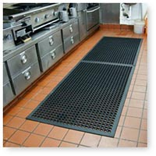
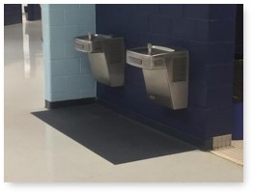
Matting
Mats for Use Near Liquid Sources

Slide 30
Slip Resistant Footwear
Proven risk reduction method for food service industry
2019 study associated slip-resistant shoes with 67% reduction in likelihood of a slip/fall injury

Slide 31
Slip Resistant Footwear
How long is a pair effective?
2014 restaurant study found workers using slip-resistant shoes with at least 6-months wear, had the same rate of slipping as those wearing street shoes!

Slide 32
Footwear Program Tips
Have in writing
Research vendors
If possible, reimburse
Specify selection, purchase, reimbursement, replacement requirements

Slide 33
Today’s Topics
The Risk-Based Approach
Solving for Slips
Housekeeping
Surface Irregularities
Behavioral Factors
Valuable Resources

Slide 34
Housekeeping Is Important!
Establish standards
Reinforce routines
Maintain accountability

Slide 35
Today’s Topics
The Risk-Based Approach
Solving for Slips
Housekeeping
Surface Irregularities
Behavioral Factors
Valuable Resources

Slide 36
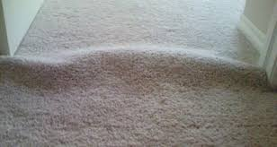
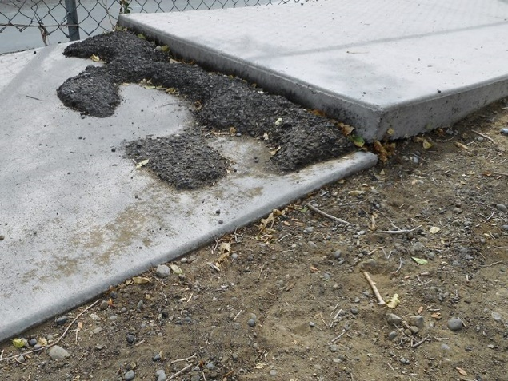
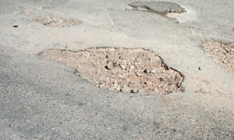
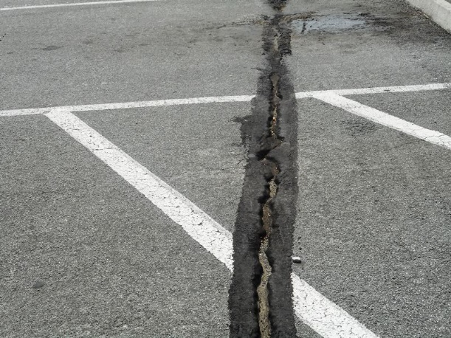
Surface Irregularities

Slide 37
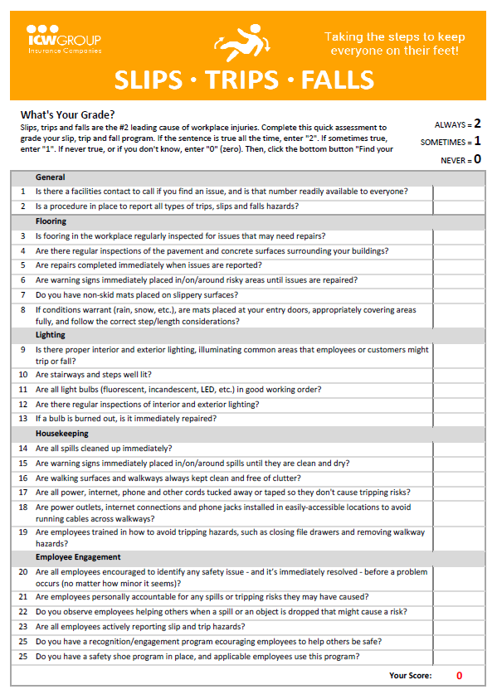
Floor Inspection
Establish inspection criteria
Establish a routine
Follow through with corrective action
Mark Uncorrected Hazards

Slide 38
Today’s Topics
The Risk-Based Approach
Solving for Slips
Housekeeping
Surface Irregularities
Behavioral Factors
Valuable Resources

Slide 39
Behavioral Factors
Rushing
Inattention
Taking Shortcuts
Load Carrying
Spill Response

Slide 40
Behavioral Motivations
“My coworkers will be slowed down if I stop to clean up my work area”
“Customers will be upset if I don’t serve them quickly”

Slide 41
Behavioral Motivations
“The more baskets of cherries I harvest the more I get paid”
“The spill cleanup kit is located on the other side of the facility”
“I get to leave early if I finish my work faster”

Slide 42
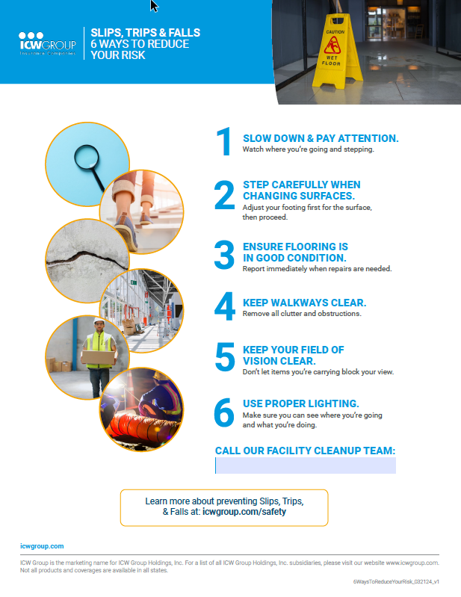
Behavioral Factors
Establish safe work methods and a safe work pace
Ensure motivation factors reinforce safe work method and pace

Slide 43
Training & Awareness Campaigns
Focus on influencing behaviors and hazard awareness
Teach techniques that tangibly reduce risk
Make sure employees know what the expectations are!

Slide 44
Today’s Topics
The Risk-Based Approach
Solving for Slips
Housekeeping
Surface Irregularities
Behavioral Factors
Valuable Resources

Slide 45
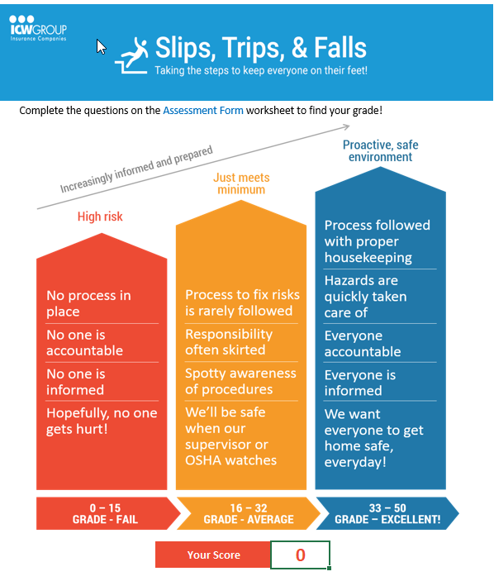
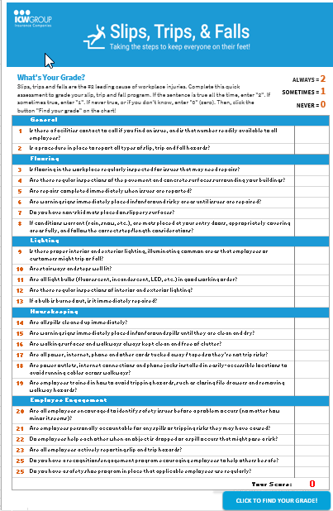
How Likely is Your Next Slip, Trip, Fall Incident?
Take our quick interactive assessment
Find your grade
Form will be available after webinar!

Slide 46
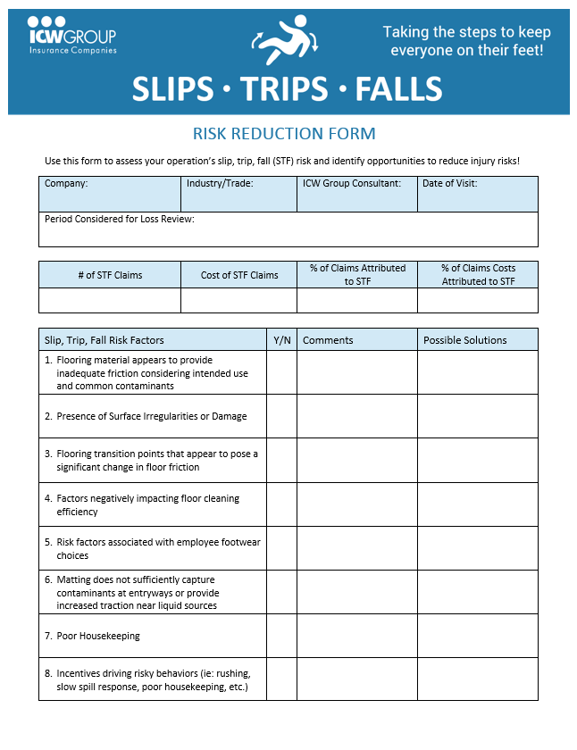
Risk Reduction Form
See the Slip, Trips and Falls Risk Reduction Form
Helps identify hazards
Offers possible solutions

Slide 47
ICW Group Policyholder Website!
icwgroup.com/safety
Safety and Risk Management area!
Safety Webinars
Slips, Trips and Falls materials
4-part video series!
Register for Safety OnDemand
FREE with your policy!

Slide 48
Questions?
riskmanagement@icwgroup.com

Slide 49
Thank You!
icwgroup.com/safety

